Slide 1
Master class-2

Slide 2
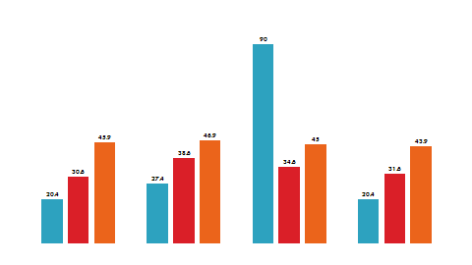
Today’s Agenda
Topics:
User Interface
HTML5
CSS3
Java script
J2EE components
Servlets
JSP
Spring Framework components
Spring Core
Spring MVC
Spring Boot
Web service architectures
SOAP, REST
JPA
Spring Data JPA

Slide 3

UI Technologies

Slide 4
HTML5[Hypertext and Markup language ]: Introduction
used to design web pages using a markup language.
HTML 5 is the fifth version of HTML.
It has improved the markup available for documents and has introduced application programming interfaces (API) and Document Object Model (DOM).
Features:
It has introduced new multimedia features which supports both audio and video controls by using <audio> and <video> tags.
Enrich semantic content by including <header> <footer>, <article>, <section> and <figure> are added.
Geo-location services- It helps to locate the geographical location of a client.
Web storage facility which provides web application methods to store data on the web browser.
Easy DOCTYPE declaration i.e., <!doctype html>

Slide 5
HTML5[Hypertext and Markup language ]: Code
<!DOCTYPE html> <html> <head> <meta charset="UTF-8"> <title>Title of the document</title> </head> <body> Content of the document...... </body> </html>
The default character encoding in HTML5 is UTF-8.

Slide 6
HTML5: Form Elements
The forms section of HTML5 was originally a specification titled Web Forms 2.0 that added new types of controls for forms.
HTML5 form attributes :There are new attributes added .
placeholder / autofocus / autocomplete / required / pattern
list / multiple / novalidate / formnovalidate / form
formaction / formenctype / formmethod / formtarget

Slide 7
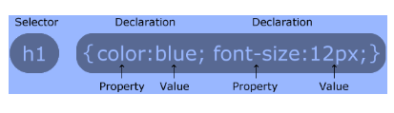
CCS3: Introduction
CSS stands for Cascading Style Sheets.
CSS describes how HTML elements are to be displayed on screen, paper, or in other media.
It can control the layout of multiple web pages all at once.
when you work with multiple web pages in a single web site by applying styles to all pages from a single file.
CSS syntax:

Slide 8
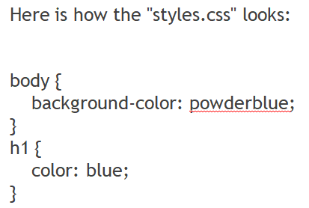
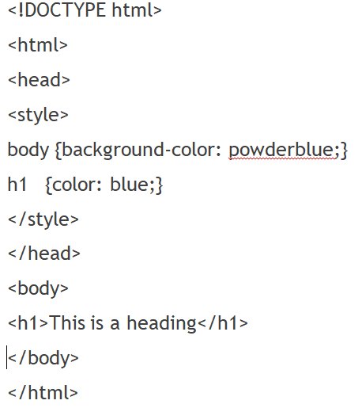
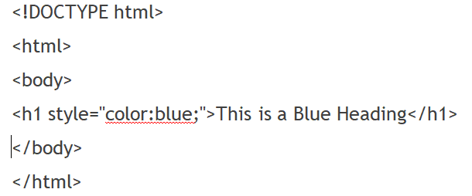
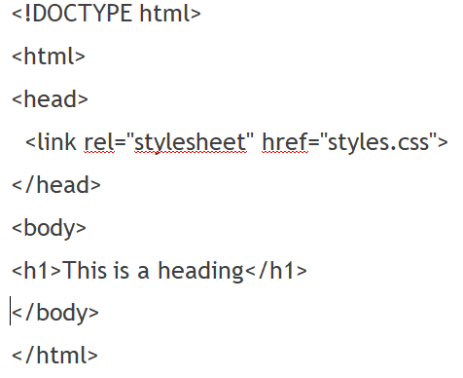
CCS3: Techniques
CSS can be added to HTML elements in 3 ways:
Inline - by using the style attribute in HTML elements
Internal - by using a <style> element in the <head> section
External - by using an external CSS file

Slide 9
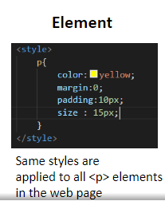
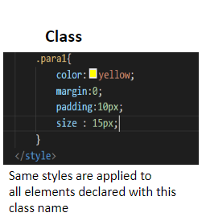
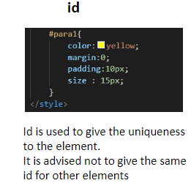
CCS3: Selectors
CSS selectors are used to identify the element to apply the styles
Element is identified using the following selectors
element
id
class

Slide 10
JS: Introduction
JavaScript is the programming language of HTML and the Web.
JavaScript is easy to learn.
In HTML, JavaScript code must be inserted between <script> and </script> tags.
You can place any number of scripts in an HTML document.
Scripts can be placed in the <body>, or in the <head> section of an HTML page, or in both.
Scripts can also be placed in external files(file extension .js.)
<script src="myScript.js"></script>
<!DOCTYPE html>
<html>
<body>
<h2>My First JavaScript</h2>
<button type="button"
onclick="document.getElementById('demo')
.innerHTML = Date()">
Click me
</button>
<p id="demo"></p>
</body>
</html>

Slide 11
JS: Uses
The <script> Tag
Scripts can be placed in the <body>, or in the <head> section of an HTML page, or in both.
<!DOCTYPE html> <html> <body> <h1>A Web Page</h1> <p id="demo">A Paragraph</p> <button type="button" onclick="myFunction()">Try it</button> <script> function myFunction() { document.getElementById("demo").innerHTML = "Paragraph changed."; } </script> </body> </html>

Slide 12
JS: Uses
The <script> Tag
Scripts can also be placed in external files(file extension .js.)
<!DOCTYPE html>
<html>
<body>
<h2>External JavaScript</h2>
<p id="demo">A Paragraph.</p>
<button type="button" onclick="myFunction()">Try it</button>
<p>(myFunction is stored in an external file called "myScript.js")</p>
<script src="myScript.js"></script>
</body>
</html>
External file: myScript.js
function myFunction() { document.getElementById("demo")
.innerHTML = "Paragraph changed."; }

Slide 13
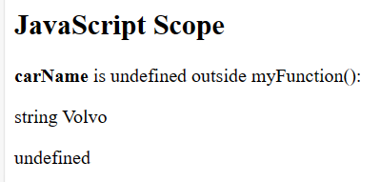
JS: Local Vs Global scope
Variables declared within a JavaScript function, become LOCAL to the function.
OUTPUT-
<!DOCTYPE html>
<html>
<body>
<h2>JavaScript Scope</h2>
<p><b>carName</b> is undefined outside myFunction():</p>
<p id="demo1"></p>
<p id="demo2"></p>
<script>
myFunction();
function myFunction() {
let carName = "Volvo";
document.getElementById("demo1").innerHTML =
typeof carName + " " + carName;
}
document.getElementById("demo2").innerHTML =
typeof carName;
</script>
</body>
</html>

Slide 14
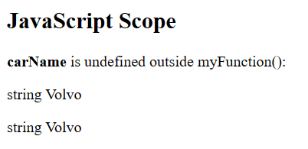
JS: Local Vs Global scope
A variable declared outside a function, becomes GLOBAL.
All scripts and functions on a web page can access it.
Output:
OUTPUT-
<!DOCTYPE html>
<html>
<body>
<h2>JavaScript Scope</h2>
<p><b>carName</b> is undefined outside myFunction():</p>
<p id="demo1"></p>
<p id="demo2"></p>
<script>
let carName = "Volvo";
myFunction();
function myFunction() {
document.getElementById("demo1").innerHTML =
typeof carName + " " + carName;
}
document.getElementById("demo2").innerHTML =
typeof carName + " " + carName;
}
</script>
</body>
</html>

Slide 15
JEE Framework

Slide 16
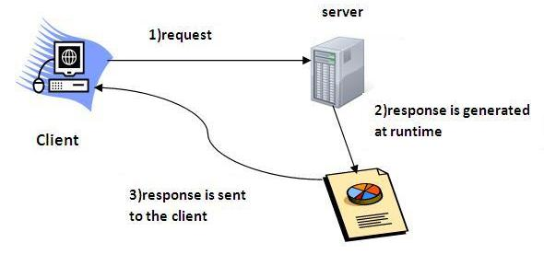
JEE Framework: Servlet
Servlet is a technology i.e. used to create web application.
Servlet is an API that provides many interfaces and classes including documentations.
Servlet is an interface that must be implemented for creating any servlet.
Servlet is a class that extend the capabilities of the servers and respond to the incoming request. It can respond to any type of requests.
Servlet is a web component that is deployed on the server to create dynamic web page.

Slide 17
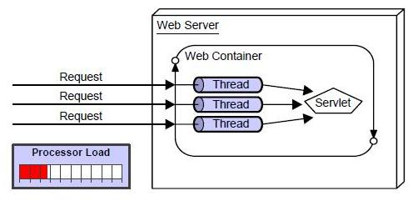
Servlet: Advantages
Better performance: because it creates a thread for each request not process.
Portability: because it uses java language.
Robust: Servlets are managed by JVM so we don't need to worry about memory leak, garbage collection etc.
Secure: because it uses java language..

Slide 18
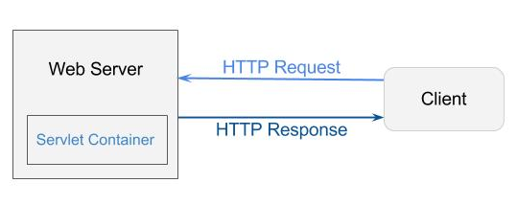
Servlet: Container
It provides the runtime environment for JEE (j2ee) applications.
The client/user can request only a static WebPages from the server.
If the user wants to read the web pages as per input then the servlet container is used in java.
The servlet container is used in java for dynamically generate the web pages on the server side.
Therefore the servlet container is the part of a web server that interacts with the servlet for handling the dynamic web pages from the client.
Performs:
Life Cycle Management
b. Multithreaded support
c. Object Pooling
d. Security etc.

Slide 19
Servlet: Code pattern
else{
out.print("Sorry UserName or Password Error!");
RequestDispatcher rd=request.getRequestDispatcher("/index.html");
rd.include(request, response);
}
}
}
public class Login extends HttpServlet {
public void doPost(HttpServletRequest request, HttpServletResponse response)
throws ServletException, IOException {
response.setContentType("text/html");
PrintWriter out = response.getWriter();
String n=request.getParameter("userName");
String p=request.getParameter("userPass");
if(p.equals("servlet"){
RequestDispatcher rd=request.getRequestDispatcher("servlet2");
rd.forward(request, response);
}

Slide 20
JSP: Introduction
JSP technology is used to create web application just like Servlet technology.
It can be thought of as an extension to servlet because it provides more functionality than servlet such as expression language, jstl etc.
It consists of HTML tags and JSP tags.
The jsp pages are easier to maintain than servlet because we can separate designing and development.
It provides some additional features such as Expression Language, Custom Tag etc.
Advantages:
JSP technology is the extension to servlet technology.
can use all the features of servlet in JSP.
In addition to, use implicit objects, predefined tags, expression language and Custom tags in JSP, that makes JSP development easy.

Slide 21
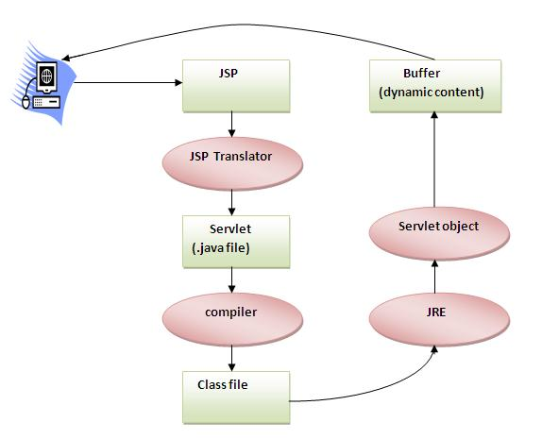
JSP: Life Cycle
The JSP pages follows these phases:
Whenever the client browser requests for a particular JSP page, the server, in turn, sends a request to the JSP engine.
A JSP engine is a part of a Web container that compiles a JSP page to a servlet.
Translation of JSP Page
Compilation of JSP Page
Class loading (class file is loaded by the classloader)
Instantiation (Object of the Generated Servlet is created).
Initialization ( jspInit() method is invoked by the container).
Reqeust processing ( _jspService() method is invoked by the container).
Destroy ( jspDestroy() method is invoked by the container).

Slide 22
JSP: Code
<%@ page language="java" contentType="text/html; charset=ISO-8859-1"
pageEncoding="ISO-8859-1"%>
<!DOCTYPE html PUBLIC "-//W3C//DTD HTML 4.01 Transitional//EN" "http://www.w3.org/TR/html4/loose.dtd">
<html>
<head>
<meta http-equiv="Content-Type" content="text/html; charset=ISO-8859-1">
<title>JSP - Hello World Tutorial - Programmer Gate</title>
</head>
<body>
<%! String data =“Hello World!” %>
<%= data%>
</body>
</html>

Slide 23
Spring Framework

Slide 24

Spring Framework: Introduction
Spring is a lightweight framework.
popular open-source Java-based framework developed by Rod Johnson in 2003.
It can be thought of as a framework of frameworks because it provides support to various frameworks such as Struts, Hibernate etc.
allows developers to use POJOs to create enterprise-class apps. The advantage of using simply POJOs is that you don’t require an EJB container product like an application server

Slide 25
Spring Framework: Advantages
Predefined Templates:
Spring framework provides templates for JDBC, Hibernate, JPA etc. technologies.
There is no need to write too much code. It hides the basic steps of these technologies.
Loose Coupling
loosely coupled because of dependency injection.
Lightweight
lightweight because of its POJO implementation.
Fast Development
supports to various frameworks makes the easy development of JavaEE application.

Slide 26
Spring Framework: Concepts
IoC (Inversion of Control) Container:
IoC container is responsible to instantiate, configure and assemble the objects.
The IoC container gets informations from the XML file and works accordingly.
The main tasks performed by IoC container are:
to instantiate the application class
to configure the object
to assemble the dependencies between the objects
There are two types of IoC containers. They are:
BeanFactory
ApplicationContext

Slide 27
Spring Framework: Concepts
IoC (Inversion of Control) Configuration:
Spring Framework provides three ways to configure beans created bin IOC to be used in the application.
Annotation Based Configuration - By using @Service or @Component annotations. Scope details can be provided with @Scope annotation.
XML Based Configuration - By creating Spring Configuration XML file to configure the beans.
Java Based Configuration - Starting from Spring 3.0, configure Spring beans using java programs.
important annotations used for java based configuration are @Configuration, @ComponentScan and @Bean.

Slide 28
Spring Framework: Concepts
DI (Dependency Injection) :
is a design pattern that removes the dependency from the programming code so that it can be easy to manage and test the application.
makes our programming code loosely coupled.
Two ways to make DI in code.
By Constructor
By Setter method

Slide 29
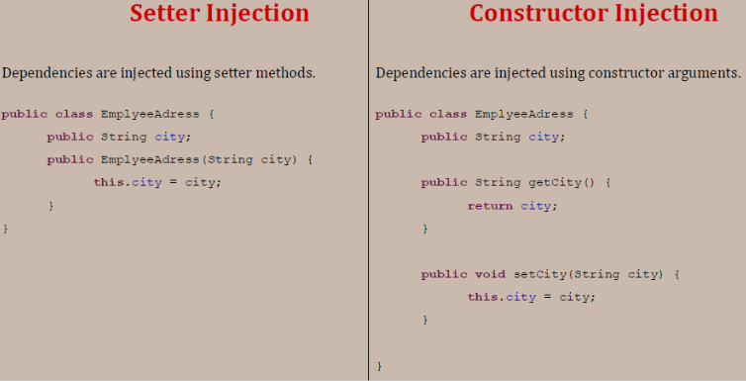
Spring Framework: Concepts
Setter vs Constructor based DI (Dependency Injection) :
Constructor-based DI fixes the order in which the dependencies need to be injected.
Setter-based DI helps us to inject the dependency only when it is required, as opposed to requiring it at construction time.
If use both constructor and setter injection, IOC container will use the setter injection.
Changes: We can easily change the value by setter injection. It doesn't create a new bean instance always like constructor. So setter injection is flexible than constructor injection.

Slide 30
Spring Web MVC

Slide 31
Spring Web MVC: Define
Spring MVC Framework follows the Model-View-Controller design pattern.
used to develop web applications.
works around DispatcherServlet.
DispatcherServlet handles all the HTTP requests and responses.
dispatches the requests to handlers.
uses @Controller and @RequestMapping as default request handlers.
@Controller annotation defines that a particular class is a controller.
@RequestMapping annotation maps web requests to Spring Controller methods.

Slide 32
Spring Web MVC: Significance
The terms model, view, and controller are as follows:
Model: The Model encapsulates the application data.
View: View renders the model data and also generates HTML output that the client’s browser can interpret.
Controller: The Controller processes the user requests and passes them to the view for rendering.

Slide 33
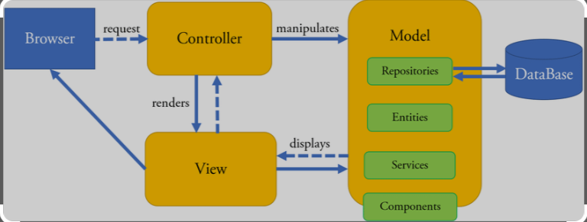
Spring Web MVC: WorkFlow
All the incoming requests are intercepted by the DispatcherServlet that works as the front controller.
The DispatcherServlet then gets an entry of handler mapping from the XML file and forwards the request to the controller.
The object of ModelAndView is returned by the controller.
The DispatcherServlet checks the entry of the view resolver in the XML file and invokes the appropriate view component.

Slide 34
Spring Web MVC: Advantages
The container is used for the development and deployment of applications and uses a lightweight servlet.
It enables rapid and parallel development.
Development of the application becomes fast.
Easy for multiple developers to work together.
Easier to Update the application.
It is Easier to Debug.

Slide 35
Web Service

Slide 36
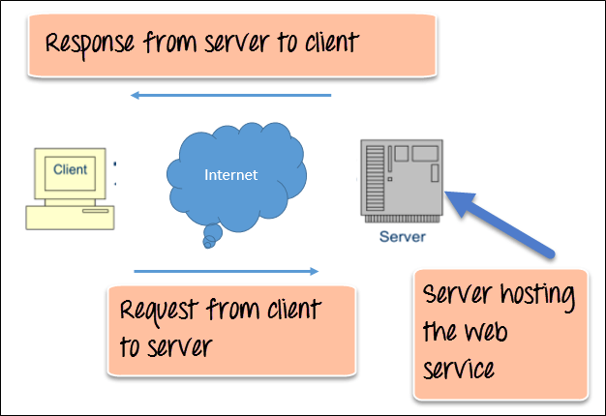
Web Service: Define
A web service is any piece of software that makes itself available over the internet and uses a standardized XML messaging system.
XML is used to encode all communications to a web service.
For example, a client invokes a web service by sending an XML message, then waits for a corresponding XML response.

Slide 37
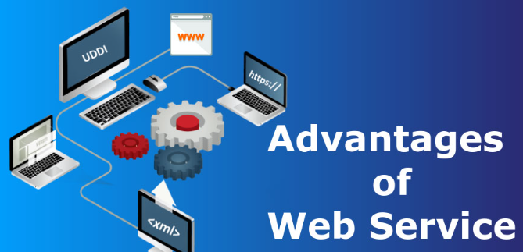
Web Service: Advantages
Web services allow various applications to talk to each other and share data and services among themselves.
Web services use standardized industry standard protocol for the communication. All the four layers (Service Transport, XML Messaging, Service Description, and Service Discovery layers) use well-defined protocols in the web services protocol stack.
Provides low cost communication compared to other reliable transport mechanisms like FTP..

Slide 38

Web Service: SOAP & REST
SOAP and REST are two internet data exchange mechanisms.
For example, imagine that your internal accounts system shares data with your customer's accounting system to automate invoicing tasks.
The two applications share data by using an API that defines communication rules. SOAP and REST are two different approaches to API design.
The SOAP approach is highly structured and uses XML data format.
REST is more flexible and allows applications to exchange data in multiple formats.
SOAP:
Simple Object Access Protocol
REST : REpresentational State
Transfer

Slide 39
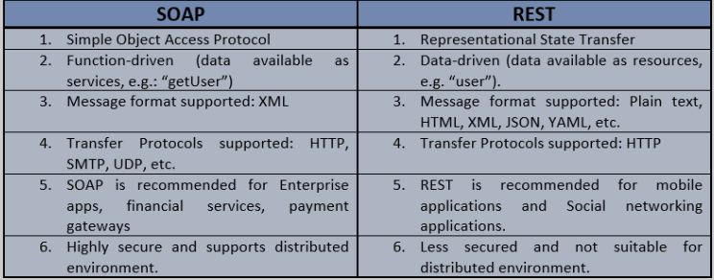
Web Service : SOAP & REST

Slide 40
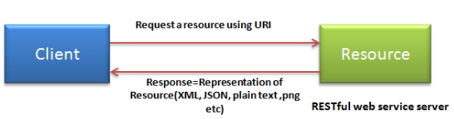
RESTFULL APIs
It is architectural style for distributed hypermedia systems
The key abstraction of information in REST is a resource.
Media Types are specified with identifiers like text/html , application/json , and application/xml , which correspond to HTML, JSON, and XML respectively, the most common web formats.
It consists of two components :
REST server which provides access to the resources
REST client which accesses and modify the REST resources.
REST : REpresentational State
Transfer

Slide 41
REST: HTTP Methods
GET:
defines a reading access of the resource without side-effects.
This operation is idempotent i.e. they can be applied multiple times without changing result.
PUT :
It is generally used for updating resource.
It must also be idempotent.
DELETE :
It removes the resources.
The operations are idempotent i.e. they can get repeated without leading to different results.
POST :
It is used for creating a new resource.
It is not idempotent.

Slide 42
JPA

Slide 43
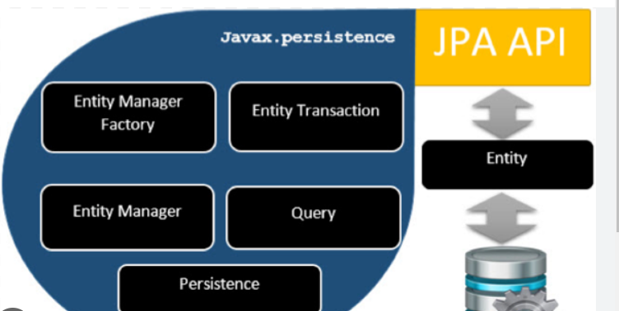
JPA: Define
Spring Boot JPA is a Java specification for managing relational data in Java applications.
It allows us to access and persist data between Java object/ class and relational database.
JPA follows Object-Relation Mapping (ORM).

Slide 44
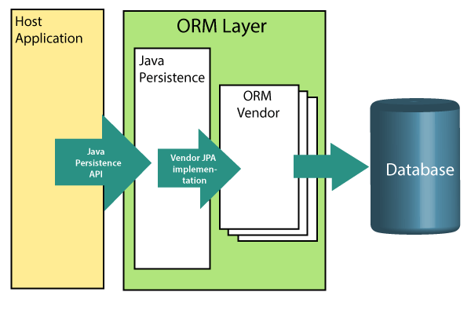
Object-Relation Mapping (ORM)
In ORM, the mapping of Java objects to database tables, and vice-versa is called Object-Relational Mapping.
The ORM mapping works as a bridge between a relational database (tables and records) and Java application (classes and objects).

Slide 45
JPA : Advantages
JPA avoids writing DDL in a database-specific dialect of SQL. Instead of this, it allows mapping in XML or using Java annotations.
JPA allows us to avoid writing DML in the database-specific dialect of SQL.
JPA allows us to save and load Java objects and graphs without any DML language at all.
When we need to perform queries JPQL, it allows us to express the queries in terms of Java entities rather than the (native) SQL table and columns.

Slide 46
JPA : Annotations
@Entity : marks this class as an entity.
@Table : specifies the table name where data of this entity is to be persisted.
If you don't use @Table annotation, JPAwill use the class name as the table name by default.
@Id : marks the identifier for this entity.
@Column : specifies the details of the column for this property or field.
If @Column annotation is not specified, property name will be used as the column name by default.
@Id : marks the identifier for this entity.
@Query : to write custom query using JPQL or Native SQL Query

Slide 47
Thank you
☺
4x3
16x9

